Slide 1
Disaster preparedness and Response Education System for Schools and Colleges. (Disaster Awareness and Response Portal)
CSE7302- Capstone Project
Review-1
Batch Number: CSE_119
Under the Supervision of,
Dr.Pamela Vinitha Eric
Professor
School of Computer Science and Engineering
Presidency University
Roll Number | Student Name
20221CSE0090 | P Vishnu Vardhan
20221CSE0195 | S Vasista
20221CSE0225 | A Dhanush
Name of the Program: CSE
Name of the HoD: Dr.Blessed Prince
Name of the Program Project Coordinator: Dr. Muthuraj
Name of the School Project Coordinators: Dr. Sampath A K , Dr. Geetha A

Slide 2
Problem Statement Number: SHI25008
Category: Software
Organization: Educational Institutions (Schools & colleges)
Problem Description: Natural disasters such as earthquakes, floods, fires, and cyclones cause severe damage to life and property every year. Schools and colleges often lack structured disaster preparedness education, practical training modules, and real-time guidance systems. Existing awareness programs are mostly theoretical, outdated, or conducted irregularly, leading to poor preparedness among students and staff. There is a need for a centralized, interactive, and accessible web-based system that educates students about disaster preparedness, safety protocols, and emergency response procedures in a simple and engaging manner.

Slide 3
Problem Statement Number: SHI25008
Problem Statement:
Educational institutions currently do not have an integrated and interactive platform to train students and staff on disaster preparedness and response. Most disaster education is limited to manuals or occasional drills, which do not ensure long-term retention or practical understanding. The lack of digital learning tools, real-time guidance, and assessment mechanisms results in panic, confusion, and unsafe actions during emergencies. Hence, there is a need for a web-based disaster preparedness education system that provides structured learning, simulations, and response guidance.
Objectives:
To create a web-based platform for disaster preparedness education.
To provide structured learning modules for different types of disasters.
To educate students on safety measures before, during, and after disasters.
To include interactive quizzes and assessments to measure awareness.
To provide emergency response guidelines in a simple and visual format.
To improve disaster readiness in schools and colleges through digital learning.

Slide 4
Problem Statement Number: SHI25008
Background & Related Work:
Traditional disaster education relies on classroom lectures, printed manuals, and occasional drills. While government agencies and NGOs provide disaster awareness materials, they are often not tailored for students or integrated into daily learning. Recent studies show that digital learning platforms, simulations, and interactive content significantly improve disaster awareness and response behavior. However, existing systems lack centralized access, student-friendly design, and institutional customization. This project builds upon existing disaster education approaches by providing a web based, interactive, and institution-focused solution.
Innovation:
Centralized web application for disaster education.
Interactive learning modules with visuals and step-by-step guidance.
Disaster-specific preparedness and response workflows.
Quiz-based evaluation to assess preparedness levels.
Easy accessibility through any web browser without additional hardware.

Slide 5
Problem Statement Number: SHI25008
Why a Web Application ?
Easy access on laptops, tablets, and mobile browsers.
No installation required.
Can be used in classrooms and remote learning.
Easy updates and scalability for institutions.
GitHub Link:
“ https://github.com/vishnu090705/Disaster-awareness-Response-portal- “

Slide 6
Problem Statement Number: SHI25008
Technology Stack:
Frontend:
HTML, CSS, JavaScript
Responsive UI for all devices
Backend:
Node.js
REST APIs for content and assessments
Database:
MySQL
Stores user progress, quiz results, and modules
Features:
Role-based access (Student / Admin)
Disaster learning modules
Interactive quizzes

Slide 7
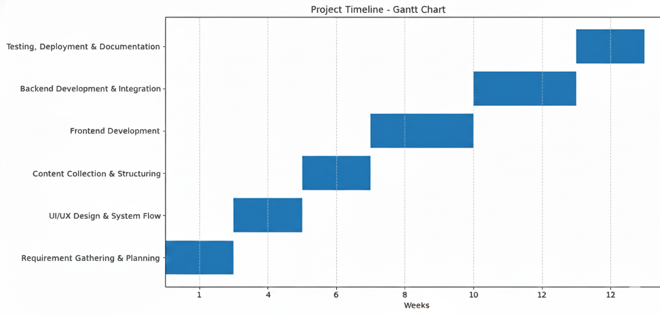
Problem Statement Number: SHI25008
Timeline of the project(Gantt Chart):

Slide 8
Problem Statement Number: SHI25008
References:
[1] A. K. Sharma and R. Gupta, “Disaster preparedness education and community resilience,” International Journal of Disaster Risk Reduction, vol. 45, pp. 101–110, 2020.
[2] United Nations Office for Disaster Risk Reduction (UNDRR), “Sendai Framework for Disaster Risk Reduction 2015–2030,” United Nations, 2015.
[3] S. Patel et al., “Web-based disaster management systems for educational institutions,” IEEE International Conference on Smart Computing, pp. 234–239, 2021.
[4] World Health Organization (WHO), “Emergency preparedness and response guidelines,” WHO Press, 2022.

Slide 9


